Slide 1
Finding Value as we develop a Vaccine.
DATA 606
Nick Calomeris

Slide 2

Rationale
We are in a time of uncertainty
Global pandemic
Protests
Presidential Race
What's the problem?
People are unsure what to do with their money
The stock market is showing a disconnect to political turmoil
01

Slide 3

Project Landscape
Be Bold
Objective...
Analyze Companies Leading the Vaccine Charge
Determine
The Winning Sectors from the Losers
Create Visuals Comparing Prior Recessions
Machine Learning to forecast the future
02

Slide 4


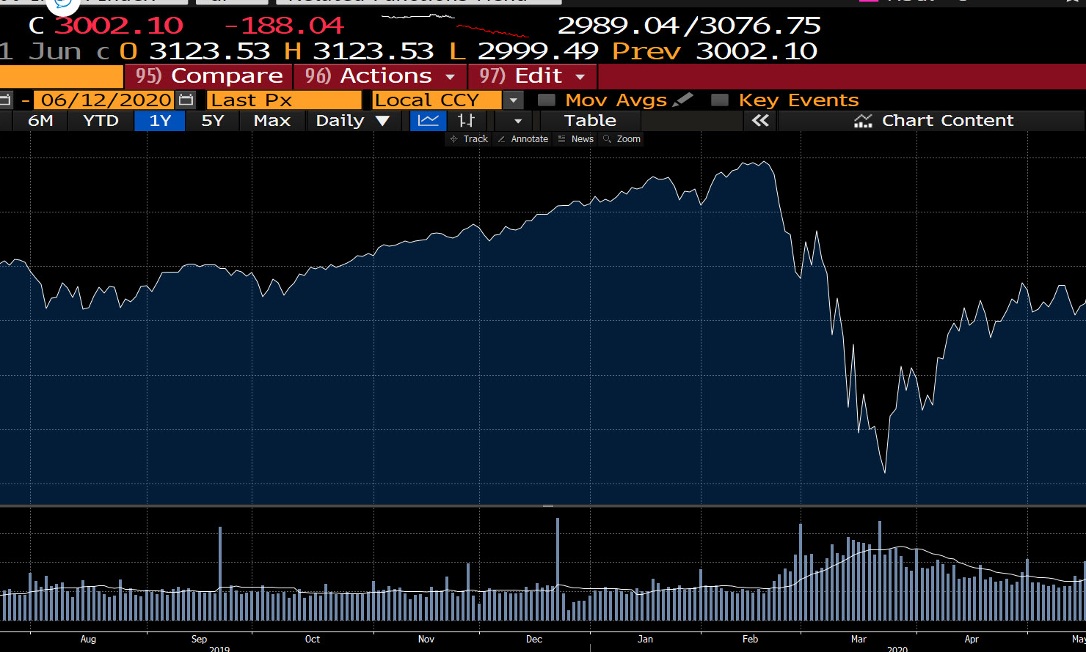
Data Sources
Data Driven, but Reproducible.
Bloomberg Terminal for EDA
Public data for project (i.e. Yahoo Finance)
03

Slide 5
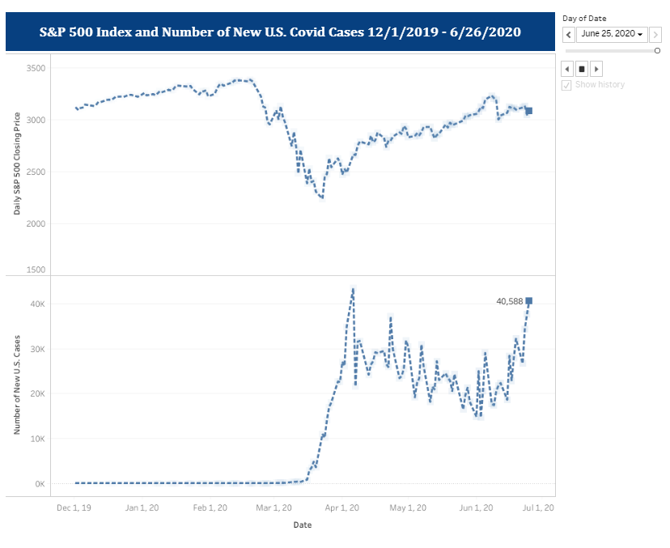
Current Landscape
03

Slide 6
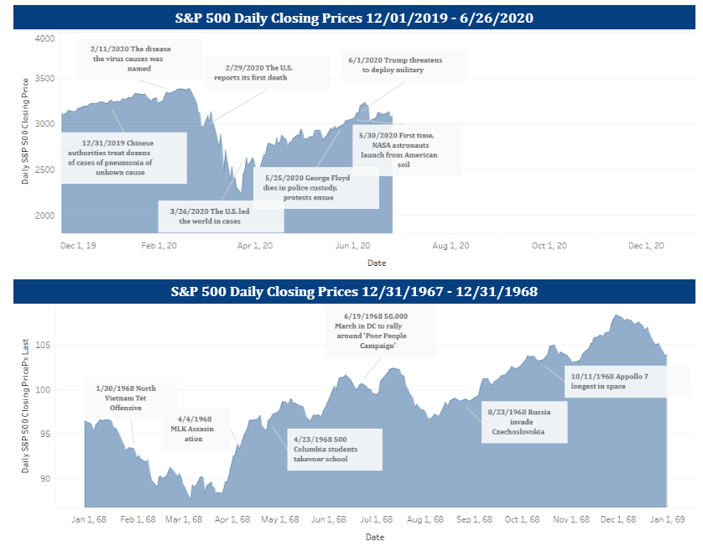
The Stock Market Doesn’t Care
03

Slide 7
Questions & Feedback?
calnick1@umbc.edu
https://github.com/calnick1/DATA606

